Slide 1

Early Prediction
Heart Failure

Slide 2
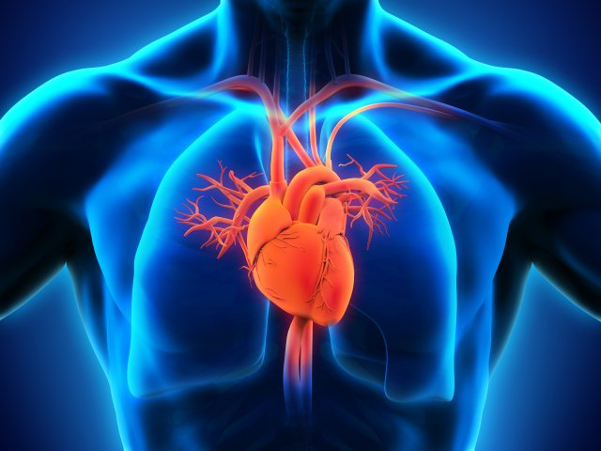



CardioVascular Diseases (CVD)
Number one cause of death globally
Heart Failure is most common
Need an early detection

Slide 3

Data Information
Consist of risk factors of Heart Failure
Age
Gender
Chest Pain
Blood Pressure
Heart Rate
Cholesterol
ECG

Slide 4

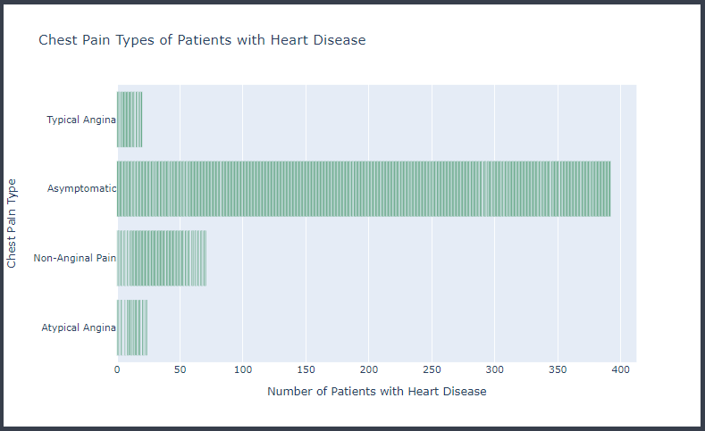





Slide 5
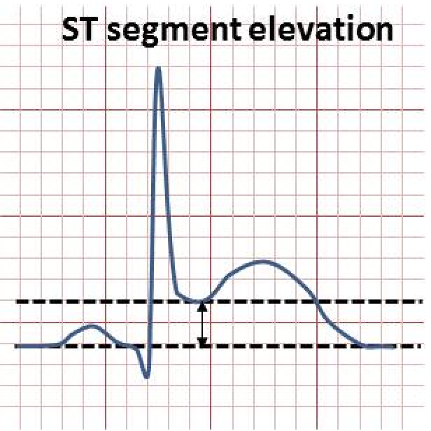
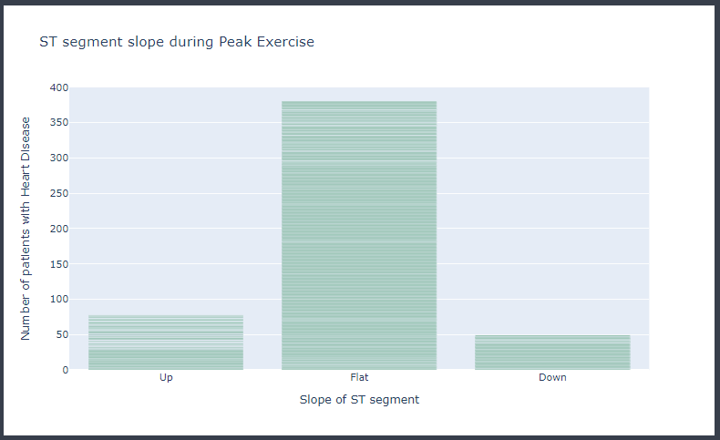
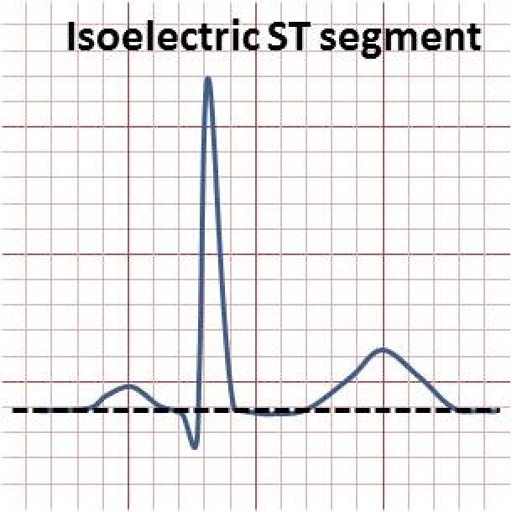
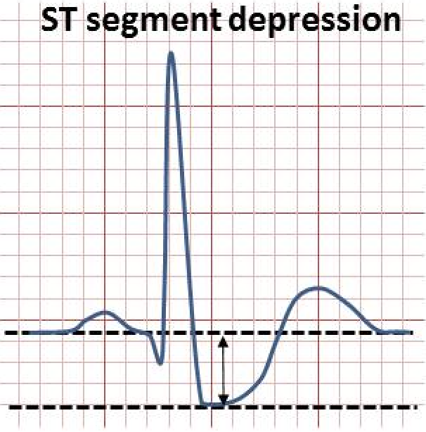

Slide 6

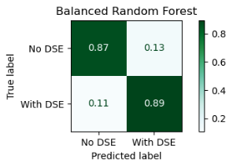
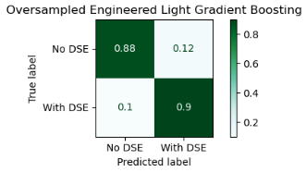
Defaulted Dataset
Random Forest (Balanced)
Engineered Dataset
Light Gradient Boosting (Oversampled)
Accuracy : 88.26%
Recall : 89.28%
Precision : 91.24%
ROC AUC: 87.97%
Accuracy : 89.13%
Recall : 90.00%
Precision : 91.97%
ROC AUC: 88.89%

Slide 7
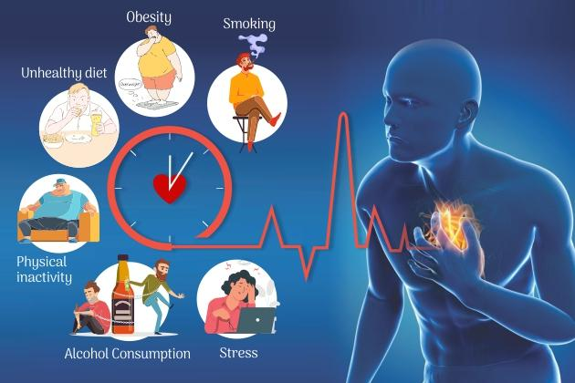
Recommendation
Include more informations on our dataset

